Slide 1

CHAPTER ONE
Research Methodology

Slide 2
What is research?
The term ‘research’ being derived from the French compound word “re-” + “cerchier”, or “sercher”
  Re - expressing intensive(concentrated) force
  Cerchier – to search
An active, diligent, and systematic process of inquiry in order to discover, interpret or revise facts, events, behaviors, or theories, to make practical applications with the help of such facts, laws, or theories.

Slide 3
Con’t…
A collection of information about a particular subject.
Creative work undertaken on a systematic basis in order to
- increase the stock of knowledge, including knowledge of man, culture and society, and the use of this stock of knowledge to devise(invent) new applications.
Original investigation undertaken in order to gain knowledge and understanding.

Slide 4
Con’t…
Research is a systematic attempt to provide answers to questions (Tuckman, 1999).
The systematic process of collecting and analyzing information (data) in order to increase our understanding of the phenomenon about which we are concerned or interested.
Research is not information gathering.
Research is not transportation of facts from one location to another, its an interpretation of facts.

Slide 5

Con’t…
An art of investigation of new and innovative aspect of any branch of knowledge.
It comprises of
  defining and redefining problems,
  formulating hypothesis (assumption that is made based on some evidence),
  suggest solutions or solution approaches,
  collecting and analyzing data,
  deriving, experimenting, and
  eventually validating the hypothesis or deducing new conclusions.

Slide 6
Con’t…
Research is, thus, an original contribution to the existing stock of knowledge making for its advancement.
It is the pursuit(search) of truth with the help of study, observation, comparison and experiment.
In short, the search for knowledge through objective and systematic method of
  finding solution to a problem or
  developing foundational theories.

Slide 7

Con’t…
The systematic approach concerning generalization and the formulation of a theory is also research.
It is actually a voyage of discovery.
Research is a culture
  To be practice through continual quest for innovation
Research is not a simple task, it needs:
  hard work,
  dedication,
  perseverance, and
  an appropriate attitude

Slide 8
Difference between Research and project
Project
Project involves a set of activities to achieve a defined outcome within a particular time.
Mostly it involves breaking a bigger problem into smaller problems and assigning each small problem to any individual and work in a team to achieve the solution of a bigger problem in small steps
There is always a defined start and end of the project (preset requirements)
The main purpose of the project is mostly to find the solution of a problem in existing system to improve its working.

Slide 9
Cont…
Research
Research involves a systematic study
There is no time limit
It involves scientific study
There is a defined start but the end may not be known

Slide 10
What is Knowledge?
Knowledge is a particular level in a hierarchy:
  1 Data
  2 Information
  3 Knowledge
  4 [Wisdom]

Slide 11
Data
Datum (Plural – Data)
  statements accepted at face value or meaning of something as it is presented or observed initially, and it can be presented as numbers, characters, images, or sounds.
  a large class of practically important statements about measurements or observations of variables, objects, or events.
  in a computing context, in a form which can be assessed, stored, processed, and transmitted by a computer.

Slide 12
Information
Data on its own has no meaning, only when interpreted by some kind of data processing system does it take on meaning and becomes information.

Slide 13
Knowledge
higher level understanding of things.
represents our understanding of the ‘why’ instead of the mere ‘what’.
interpretation of information in the form of rules, patterns, decisions, models, ideas, etc.
information combined with experience, context, interpretation, and reflection.
high-value form of information, ready to apply to decisions and actions.

Slide 14
Motivation for Research
Intellectual satisfaction of doing something innovative.
Meaningful and long-lasting contribution towards the advancement of mankind and society.
Enjoy the challenges of solving unsolved problems.
Attain higher level of understanding of fundamental concepts as well as practical significances.
Degrees, financial benefits, and respect comes along the way.

Slide 15
Aims of Research
Why do we do research?
To Answer unanswered questions,
To Solve the unsolved problems,
To build knowledge and facilitate efficient learning,
To understand various issues,
To know the truth and prove lies, and
To seek opportunities

Slide 16
Research characteristics
  Originates with a question or problem.
  Requires clear articulation of a goal.
  Follows a specific plan or procedure.
  Often divides main problem into subproblems.
  Guided by specific problem, question, or hypothesis.
  Accepts certain critical assumptions.
  Requires collection and interpretation of data.
  Suggests possible solutions to the problem.

Slide 17
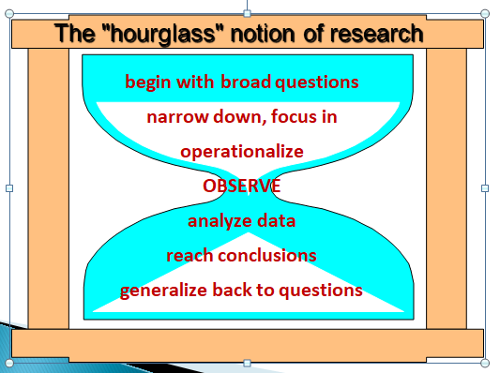
Structure of research

Slide 18
The Scientific Research Method
Systematic; cyclic; series of logical steps.
  Identifying the problem
  Formulating a hypothesis
  Developing the research plan
  Collecting and analyzing the data
  Interpreting results and forming conclusions

Slide 19
Process of research
The process is initiated with a question or problem (step 1)
Next, goals and objectives are formulated to deal with the question or problem (step 2)
Then the research design is developed to achieve the objectives (step 3)
Results are generated by conducting the research (step 4)
Interpretation and analysis of results follow (step 5)

Slide 20
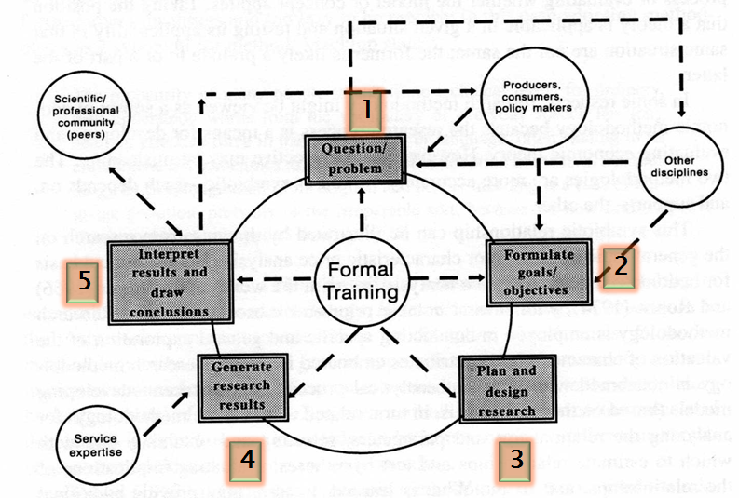
Con’t…

Slide 21
Characteristics of an effective research report
Focus: an effective report emphasizes the important information.
Accuracy: an effective report does not mislead the reader.
Clarity: an effective report does not confuse the reader.
Conciseness: an effective report does not waste the reader’s time.

Slide 22
Originality
Doing something that has not been done before.
There is no point in repeating the work of others and discovering or producing what is already known.
Exploring the unknown.
Investigate a field that no one has investigated before.

Slide 23
Con’t…
Obtaining unexpected results and investigating new directions in an already existing field.
Interpret data in new ways.
Apply new tools/techniques to alternative problems.
Try procedures/methods in new contexts.

Slide 24
Point to be remember
Research cannot be taught or improvised (created without preparation)
  It depends on practices
It does not follow an on-off model
  You have to live with it.
  It is difficult to schedule it.
Continuous nourishment is essential
  Get what ever knowledge is necessary
Research dictates its own pace and direction
  Should not be imposed upon

Slide 25
Criteria of Good Research
The purpose of the research should be clearly defined.
The research procedure used should be described in sufficient detail to permit another researcher to repeat the research for further advancement, keeping the continuity of what has already been attained.
The procedural design of the research should be carefully planned to yield results that areas objective as possible.( the procedural design should be planned as to achieve the objective.)

Slide 26
Con’t…
The researcher should report with complete frankness, flaws in procedural design and estimate their effects upon the findings.
The analysis of data should be sufficiently adequate to reveal its significance and the methods of analysis used should be appropriate.
The validity and reliability of the data should be checked carefully.

Slide 27
Con’t…
Conclusions should be confined (narrowed) to those justified by the data of the research. (researchers should avoid making assumptions or drawing conclusions that are not supported by the evidence or data gathered during the study.)
Greater confidence in research is necessary, if the researcher is experienced, has a good reputation in research and is a person of integrity.

Slide 28
Techniques Involved in Defining a Problem
State the problem in a general way: the researcher may himself read the concerned subject matter thoroughly or take the help of the subject expert.
Understand the nature of the problem: understand the nature and origin of the problem.

Slide 29
Con’t…
Survey the available literature: to identify the data available, the techniques that might be used, types of difficulties that may be encountered during the study, possible analytical shortcomings, and even new methods of approach to the present problem.
Go for discussions for developing ideas: researcher may discuss the problem with his/her colleagues and others related to the concerned subject.

Slide 30
Con’t..
Rephrase the research problem into a working proposition: putting the problem in specific terms that is feasible and may help in the development of working hypotheses.
Example: “Hate speech detection using machine learning for Amharic language”
Rephrasing the problem in to working proposition: "Investigating the efficiency of machine learning algorithms for detecting hate speech in the Amharic language."

Slide 31
Types of research
Types of research can be classified in many different ways.
some major ways of classifying research include the following:
Descriptive vs Analytical Research
Applied vs Fundamental Research
Qualitative vs Quantitative Research
Conceptual vs Empirical Research

Slide 32
1. Descriptive vs Analytical
Descriptive research
Descriptive research describes characteristics or behaviors without seeking to explain why they occur.
Ex. summarizing the distribution of grades in a class, such as the number of students who received A's, B's, C's, etc., without delving into the reasons behind the grades.
In contrast Analytical research explores relationships between variables to understand causes or effects.
Example: A study analyzing the relationship between smoking habits and lung cancer rates to determine if there's a causal link.

Slide 33
2. Applied vs Fundamental
Applied research is carried out to find answers to practical problems (when the decision is needed to be made on real life problems).
Applied research has a problem-solving emphasis.
It is mostly done by younger teachers and scholars.
Fundamental research is carried out as more to satisfy intellectual curiosity, than with the intention of using the research findings for any immediate practical application to explore certain issues and elements.
It is mostly used for elder scientists and professors.

Slide 34
3. Quantitative vs qualitative
Qualitative research: focuses on non-numerical data such as texts and images to deduce conclusions..
Ex:analyzing user feedback and comments on a software interface to deduce conclusions about usability issues and user preferences.
In contrast quantitative research Focuses on collecting numerical data and performing statistical analysis.
Example: Analyzing the response times of different algorithms for sorting data to determine which one is the most efficient..

Slide 35
4. Conceptual vs Empirical
Conceptual research involves developing new ideas or theories using logical reasoning and existing knowledge.
It doesn't involve experiments or data collection but focuses on exploring abstract concepts..
Does not include any test and empirical investigation
In contrast empirical research involves gathering and analyzing data to test hypotheses or answer research questions..

Slide 36

RM
Work Smart, Not Hard !!!

